Slide 1
Assignment 6:
Constraint Satisfaction Problem (CSP)
Constanza Madrigal Reyes A01226021
TC2011 Intelligent Systems
September 2, 2018

Slide 2
4-Queens problem by Constraint Satisfaction
Variables:
x_{i} → x₁, x₂ , x₃ , x₄
Domains:
D_{i} = {1, 2, 3, 4}, values can take each X_{i}
Constraints:
C_{i} = ( x_{i} ≠ x_{j} and | x_{i} - x_{j} | ≠ | i - j | ) ,
such that there are non attacking queens in the board
Initial State (S):
x₁
x₂
x₃
x₄
1
2
3
4

Slide 3

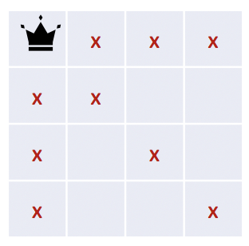
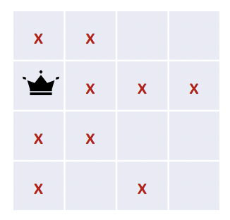
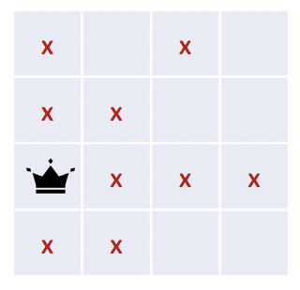
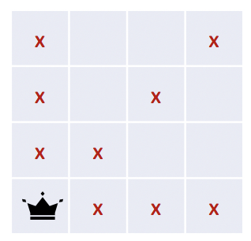
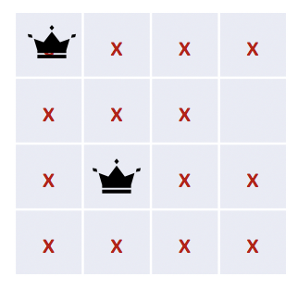
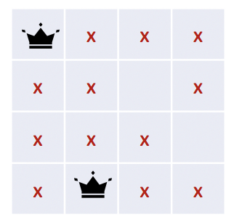
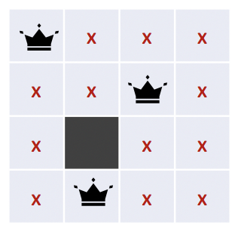
START
Depth = 0
Depth = 1
X₁ = 1
X₁ = 2
X₁ = 3
X₁ = 4
No solution for X₃ from X₂ = 3, so we continue expanding X₂ = 4
Depth = 2
X₂ = 3
X₂ = 4
Depth = 3
X₃ = 2
Depth = 4

Slide 4
START
Depth = 0
Depth = 1
X₁ = 1
X₁ = 2
X₁ = 3
X₁ = 4
Depth = 2
X₂ = 3
X₂ = 4
No solution for X₄ from X₃= 2 and there is not other possible solution from X₂ = 4, so we have to backtrack
Depth = 3
X₃ = 2
Depth = 4

Slide 5
START
Depth = 0
Depth = 1
X₁ = 1
X₁ = 2
X₁ = 3
X₁ = 4
No other unexplored solution for X₂ from X₁ = 1, so backtrack again
Depth = 2
X₂ = 3
X₂ = 4
Depth = 3
X₃ = 2
Depth = 4

Slide 6
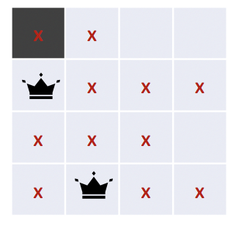
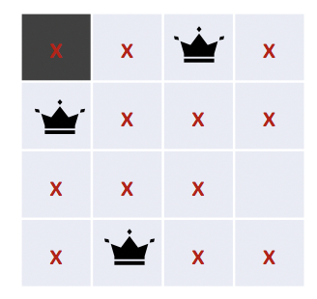
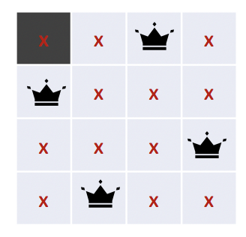
START
Depth = 0
Depth = 1
X₁ = 1
X₁ = 2
X₁ = 3
X₁ = 4
Depth = 2
X₂ = 3
X₂ = 4
X₂ = 4
Depth = 3
X₃ = 2
X₃ = 1
One solution found:
x₁ ← 2
x₂ ← 4
x₃ ← 1
x₄ ← 3
Depth = 4
10 nodes constructed
4 bytes x node = 40 bytes total
1 sec x node = 10 secs
X₄ = 3

